Slide 1
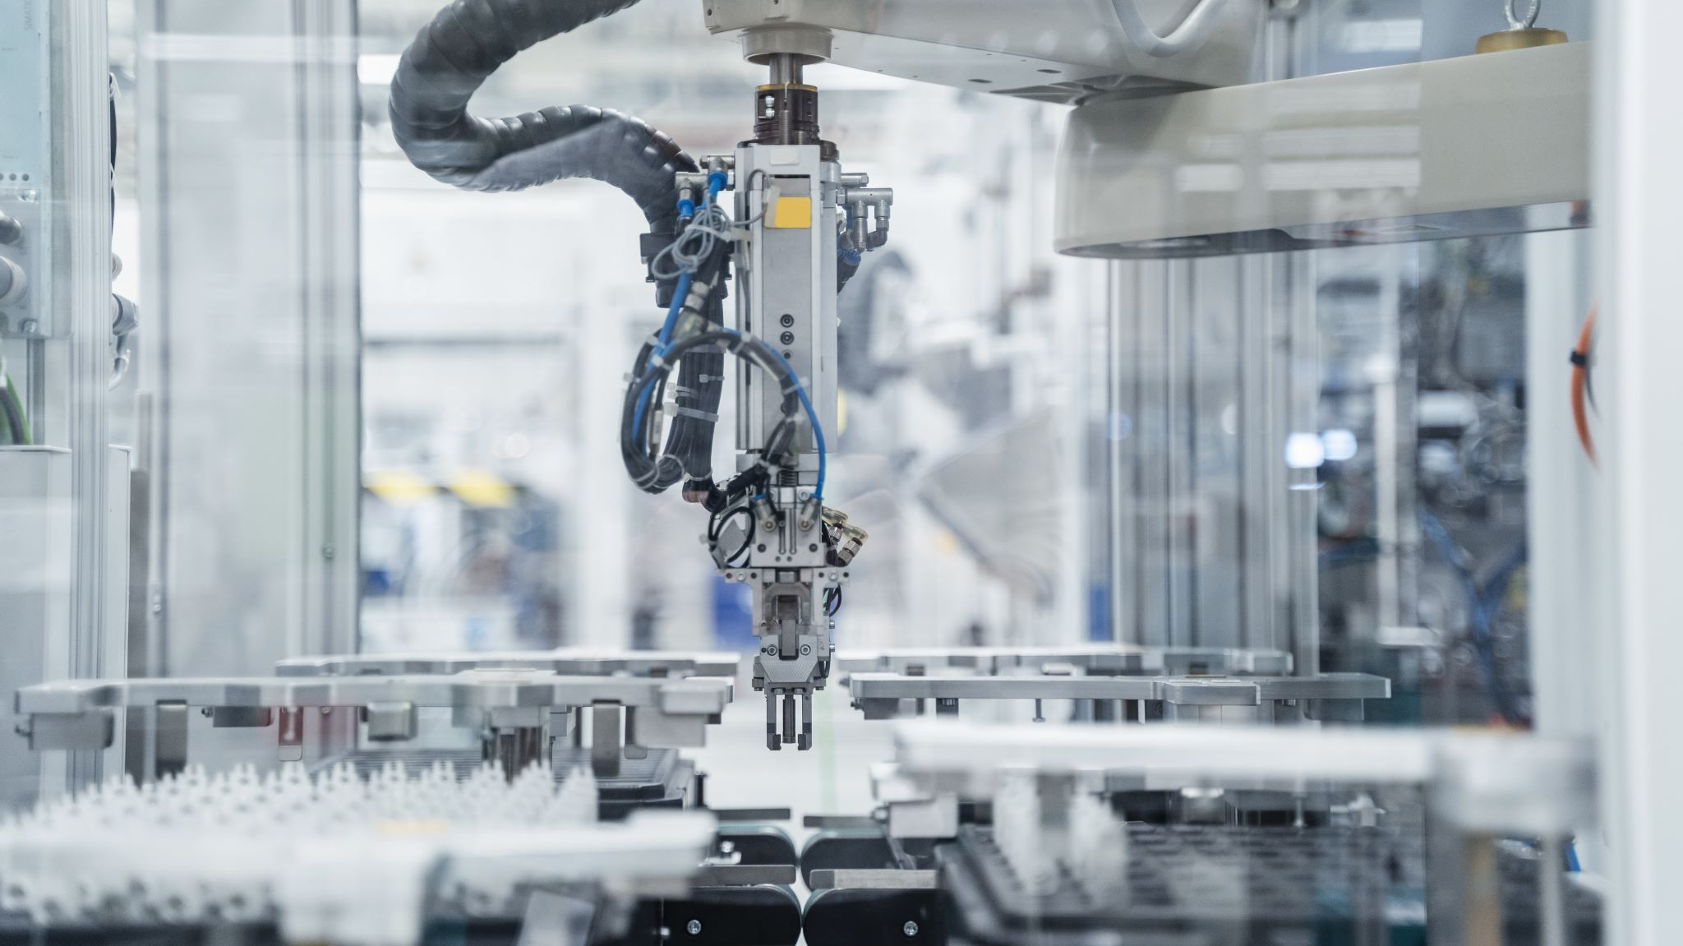

Robotic Arm Control and Task Training through Deep Reinforcement Learning
Robotic Course
Scientific Computing Department
Faculty Of Computer and Information Science
Ain Shams University
Andrea Franceschetti1, Elisa Tosello1, Nicola Castaman1, and Stefano Ghidoni1

Slide 2

Team Members:
Osama Anter Mohamed Afify
Ahmed Mohamed Ibrahim Mohamed
Adham Mohamed Tawfik Mohamed
Ahmed Mohamed Ali Abdelrahman
Tarek Ashraf Mahmoud Hussein
Under Supervise
Dr. Mohamed Marey
This Photo by Unknown Author is licensed under CC BY-NC

Slide 3
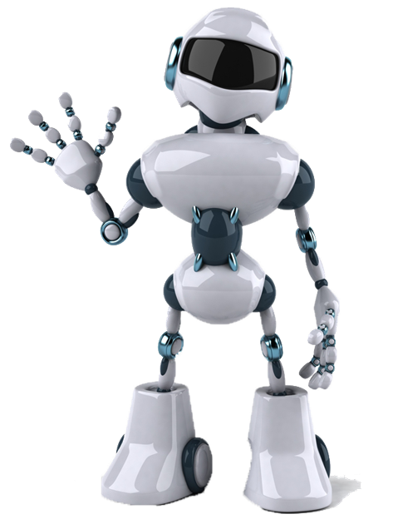
Intro.
The paper "Robotic Arm Control and Task Training through Deep Reinforcement Learning" presents a framework for training a robotic arm to perform a variety of tasks using deep reinforcement learning. The authors propose a hierarchical approach to controlling the arm, with a high-level planner that generates task-specific goals and a low-level controller that executes the arm's movements. The system is trained using a combination of imitation learning and reinforcement learning, with the goal of enabling the arm to perform a wide range of tasks in real-world environments.

Slide 4
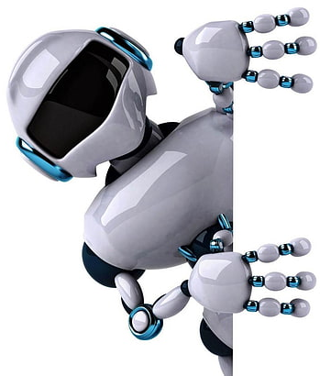
Idea
The authors use a combination of imitation learning and reinforcement learning to train the arm. In imitation learning, the arm learns by observing human demonstrations and trying to replicate them. In reinforcement learning, the arm learns by receiving rewards for completing tasks. The authors also use a hierarchical approach to control the arm, with a high-level planner that generates task-specific goals and a low-level controller that executes the arm's movements.

Slide 5
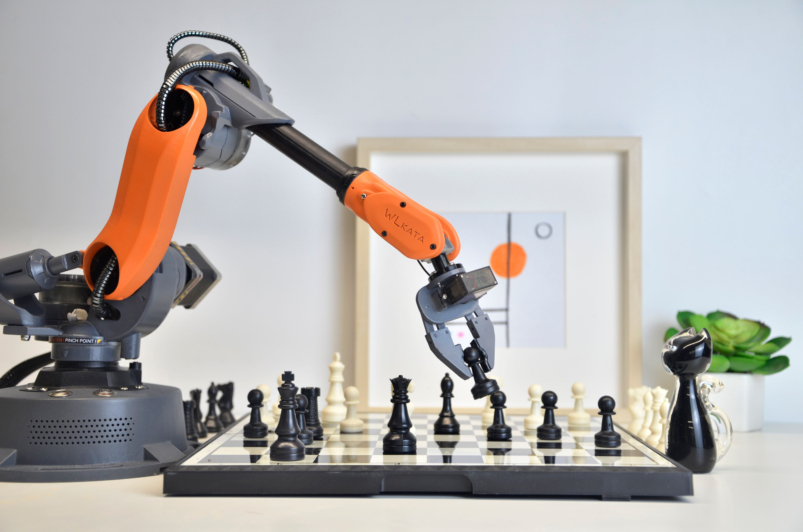
The Goal & Robot Platform
The goal is to enable the robotic arm to perform a wide range of tasks with high accuracy and efficiency, without the need for task-specific programming or manual calibration.
The proposed method involves using a DRL-based controller to learn a policy that maps the current state of the robotic arm to an optimal control action. The DRL-based controller interacts with the environment and receives a reward signal based on the success of the task. The reward signal is used to update the policy, allowing the controller to learn from experience and improve its performance over time.

Slide 6
Algorithms
The paper presents a comparison of four deep reinforcement learning (DRL) algorithms for robotic arm control:
Trust Region Policy Optimization (TRPO),
Deep Q-Network with Normalized Advantage Functions (DQN-NAF),
Deep Deterministic Policy Gradient (DDPG),
Vanilla Policy Gradient (VPG).
The authors evaluate the algorithms on two tasks: reaching a random target pose and pick-and-place.

Slide 7
definitions
algorithms
TRPO
VPG
DDPG
DQN-NAF
TRPO → is a policy gradient algorithm that uses a trust region to constrain the policy updates.
DQN-NAF → is a Q-learning algorithm that uses normalized advantage functions to improve the stability of learning.
DDPG → is an actor-critic algorithm that uses a deterministic policy and a critic to estimate the value function.
VPG → is a policy gradient algorithm that uses the REINFORCE algorithm to update the policy.

Slide 8
Here are some additional details about the four DRL algorithms that were evaluated in the paper
TRPO
VPG
DDPG
DQN-NAF
algorithms

Slide 9
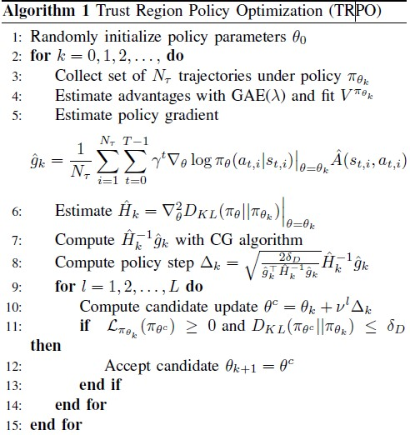
1- Trust Region Policy Optimization (TRPO)
is a policy gradient algorithm that uses a trust region to constrain policy updates. This helps to prevent the policy from diverging during training.

Slide 10
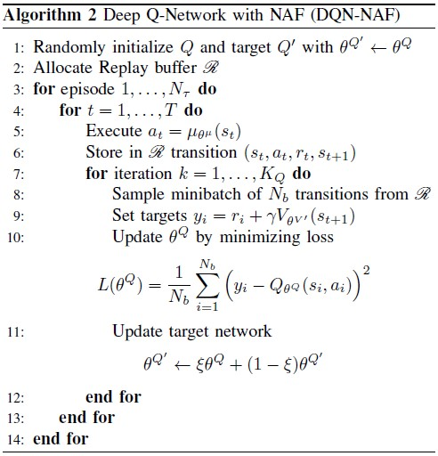
2- Deep Q-Network with Normalized Advantage Functions (DQN-NAF)
The Deep Q-Network with Normalized Advantage Functions (DQN-NAF) is a combination of the DQN and NAF algorithms used in deep reinforcement learning. The DQN-NAF algorithm uses a critic network from NAF to estimate Q-values, an actor network to select actions based on a Gaussian policy, and a replay buffer to store experiences. The DQN-NAF algorithm combines the stability and efficiency of DQN “improve the stability of learning” with the improved exploration and exploitation of NAF to create a more robust and efficient deep RL algorithm.
This helps to prevent the Q-function from overestimating the value of future rewards.

Slide 11
3- Deep Deterministic Policy Gradient (DDPG)
is an actor-critic algorithm that uses a deterministic policy and a critic to estimate the value function. This helps to improve the efficiency of learning by reducing the variance of the policy updates.

Slide 12
4- Vanilla Policy Gradient (VPG)
is a policy gradient algorithm that uses the REINFORCE algorithm to update the policy. REINFORCE is a simple policy gradient algorithm that is easy to implement, but it can be unstable during training.

Slide 13
System Architecture
The system architecture consists of two components: a high-level planner and a low-level controller.
The high-level planner generates task-specific goals.
low-level controller executes the arm's movements to achieve those goals.
The arm used in this study is a 6-DOF robotic arm with a parallel gripper.

Slide 14
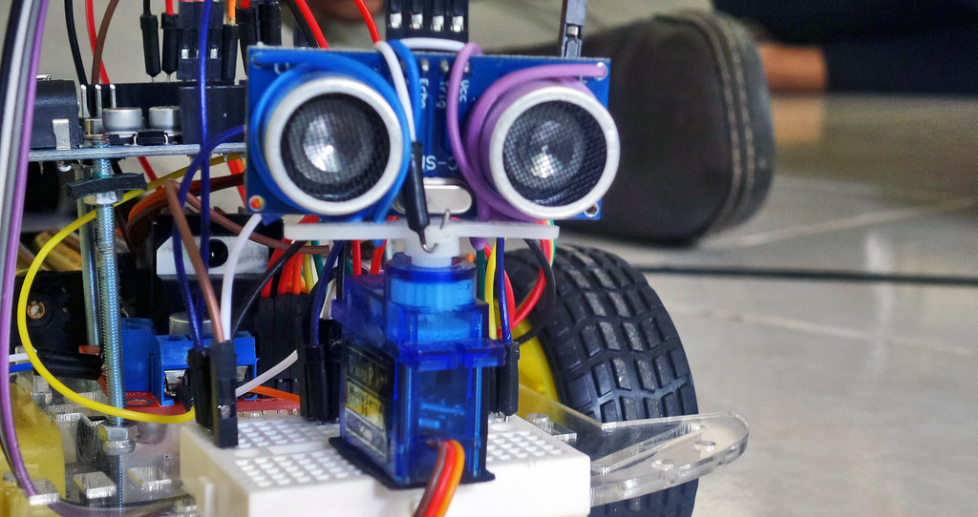
Sensors and Data:
The arm is equipped with encoders to measure the joint angles and a depth camera to perceive the environment. The depth camera is used to generate point clouds, which are then processed to extract features for use in the high-level planner.

Slide 15
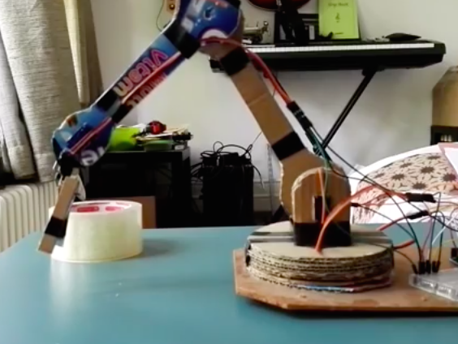
Applications
The proposed framework has potential applications in a variety of industries, including manufacturing, logistics, and healthcare. The ability to train a robotic arm to perform a wide range of tasks could improve efficiency and reduce costs in many industries.
Some of the tasks that the robotic arm was trained to perform include:
Grasping and moving objects to specific locations
Pushing objects to specific locations
Opening and closing drawers
Turning a valve
Moving a lever

Slide 16


Slide 17
Experiments
In these experiments, they used a simulated environment to train and test the robotic arm.
The simulated environment consists of a table with objects placed on it. The depth camera mounted on the arm is used to generate point clouds of the objects, which are then used by the high-level planner to generate task-specific goals. The arm's movements are simulated using physics-based simulation software.
The authors evaluated the performance of their framework by testing the arm's ability to perform a variety of tasks, including grasping and moving objects to specific locations, pushing objects to specific locations, opening and closing drawers, turning a valve, and moving a lever. They compared the performance of their framework to that of a baseline method, which uses a handcrafted controller to perform the same tasks.

Slide 18
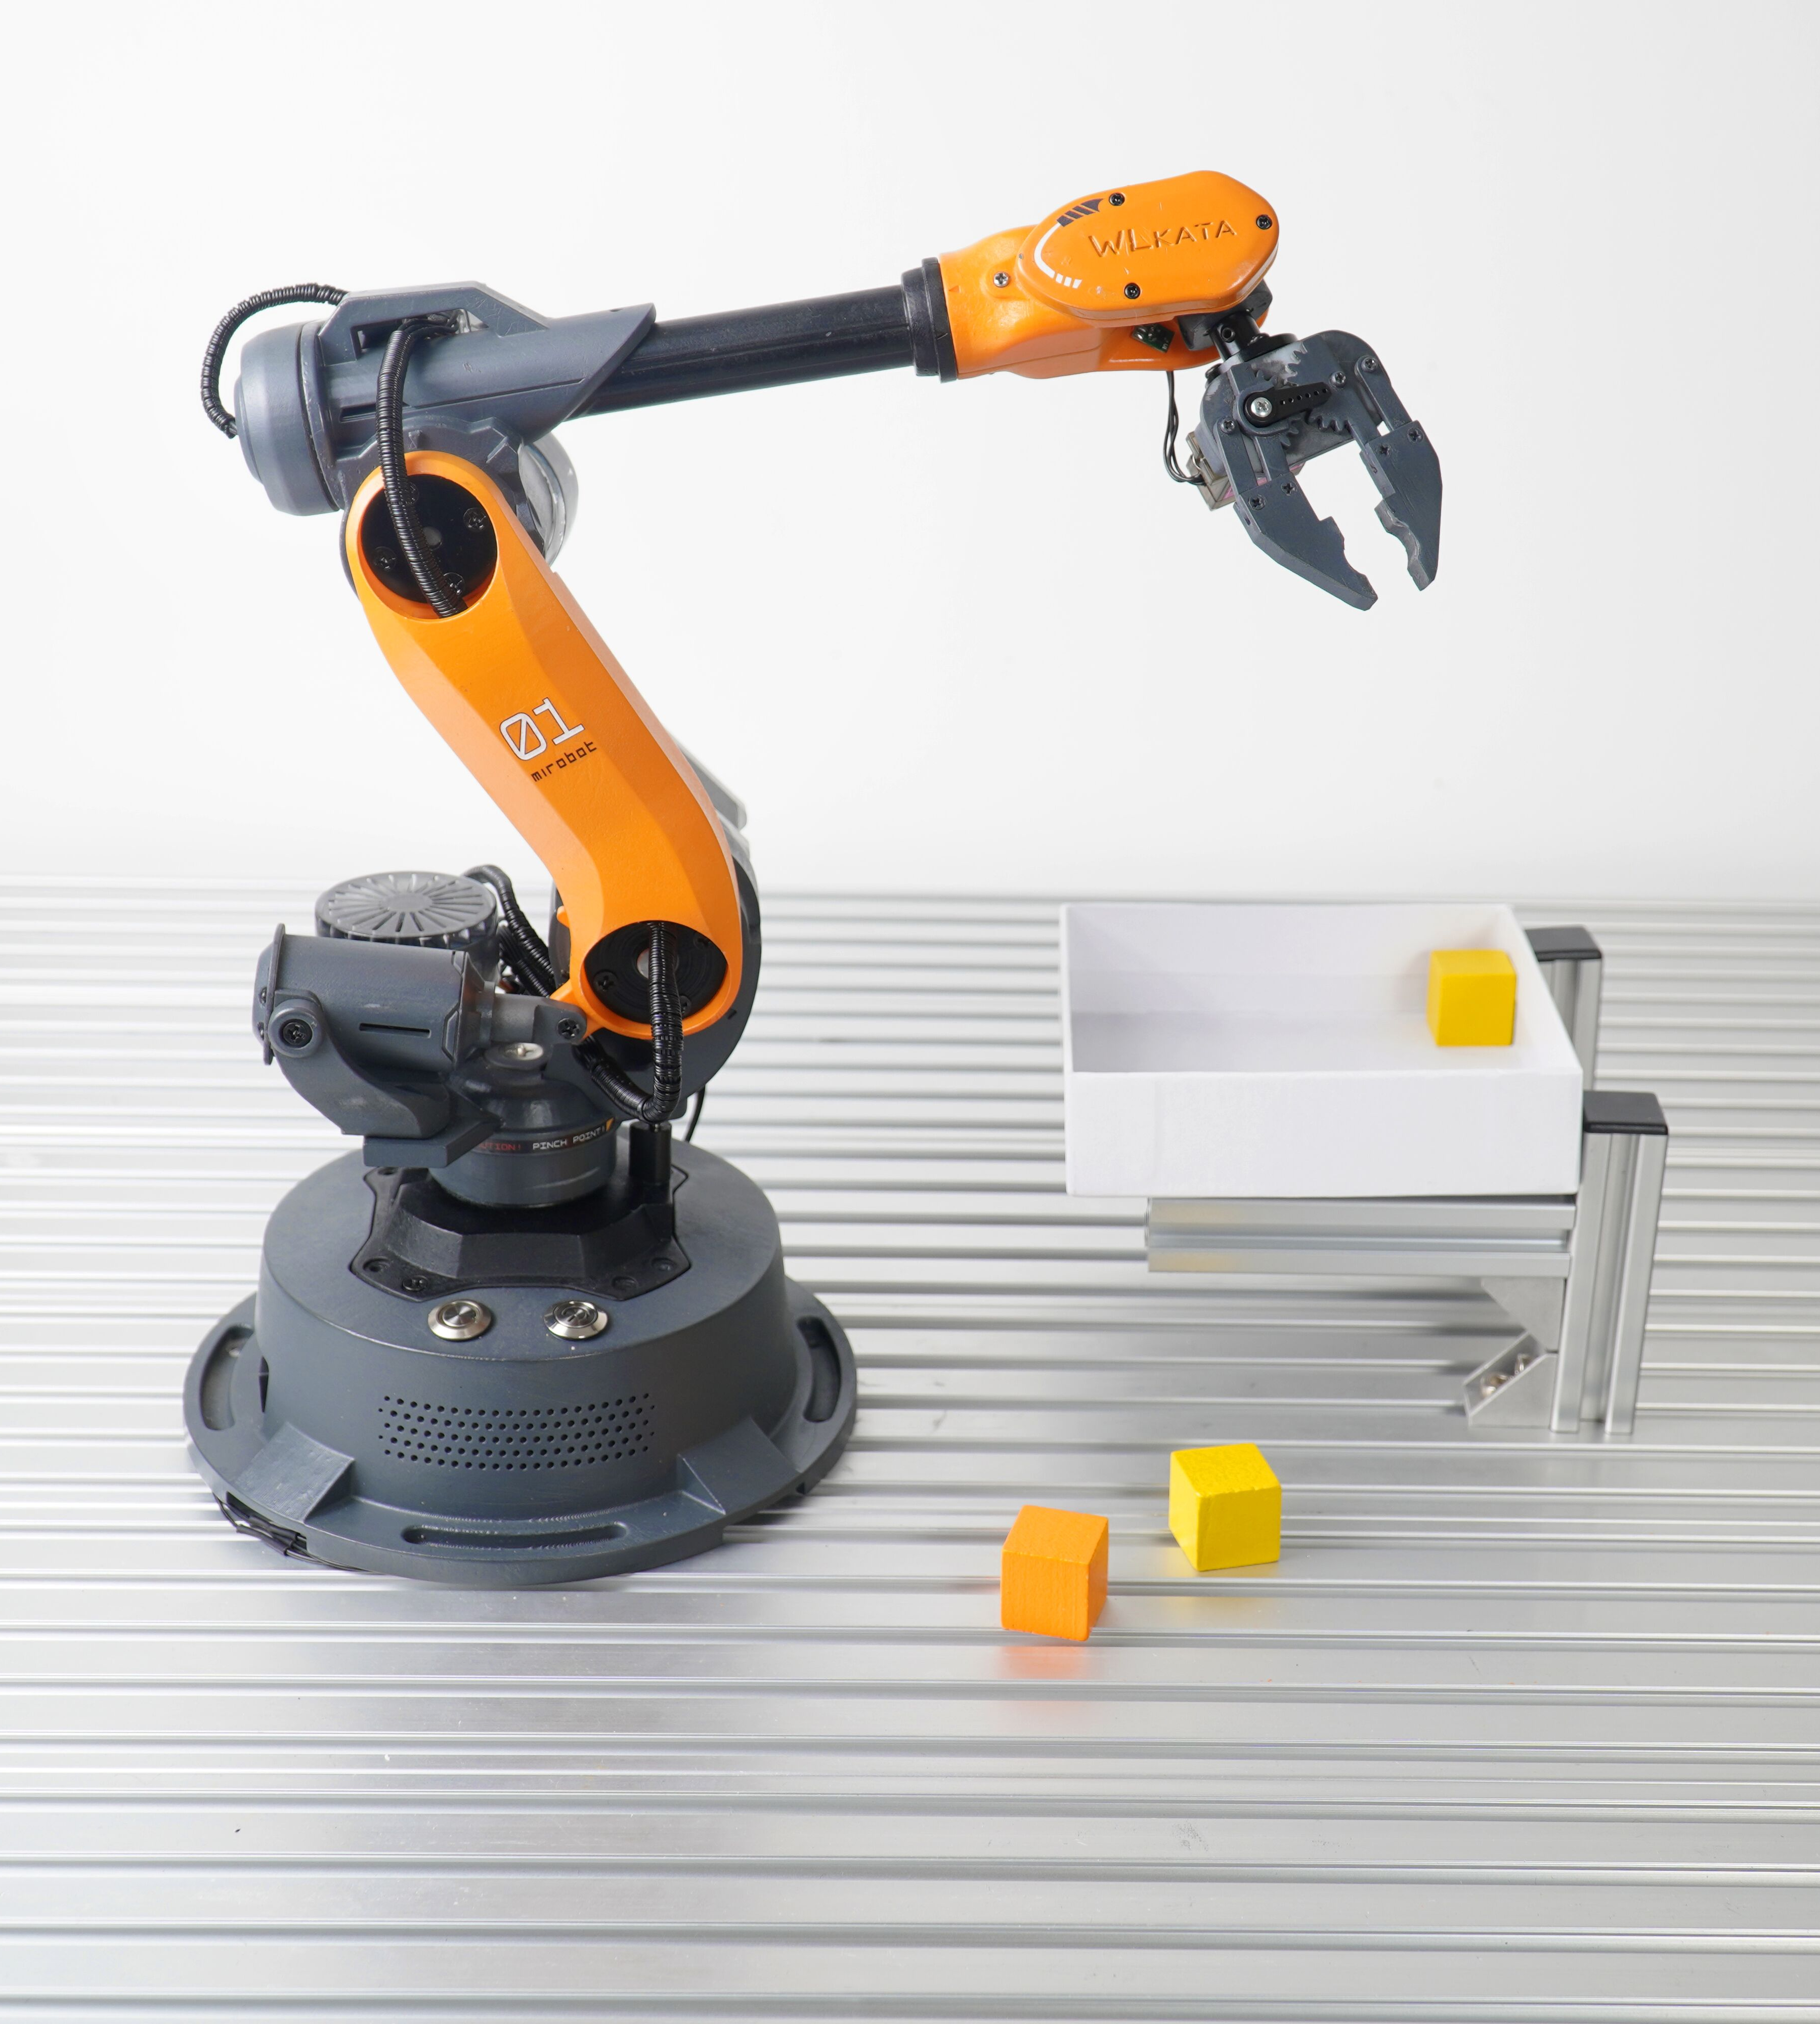
Example:
The authors evaluate their method on a simulated robotic arm.
They train the arm to perform two tasks:
reaching a random target pose
pick-and-place an object.
The authors show that their method can learn to perform both tasks successfully.

Slide 19
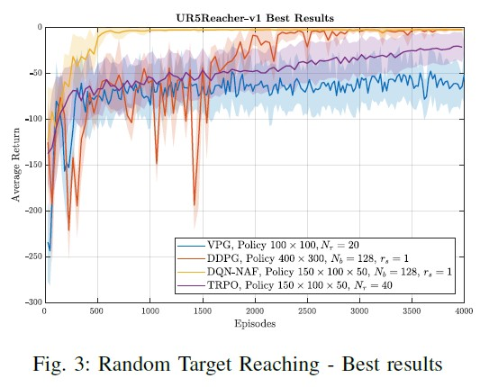
Results
The results of the simulated experiments show that the proposed framework outperforms the baseline method in terms of success rate and task completion time. The arm was able to perform a wide range of tasks in the simulated environment, demonstrating the effectiveness of the proposed framework.

Slide 20
Results
The authors found that TRPO and DQN-NAF performed the best on both tasks. TRPO was able to reach the target pose more quickly and consistently than the other algorithms. DQN-NAF was able to pick and place the object more accurately than the other algorithms.
The authors conclude that TRPO and DQN-NAF are the best DRL algorithms for robotic arm control. They are more effective than other algorithms at reaching target poses and pick-and-place objects.
The authors note that the experiments were conducted in simulation. They plan to conduct further experiments in the real world to evaluate the performance of the algorithms in a more challenging environment.

Slide 21
References:
TRPO → https://youtu.be/CKaN5PgkSBc
DQN-NAF → https://medium.com/analytics-vidhya/naf-normalized-advantage-function-dqn-for-continuous-control-tasks-b9dcb6ebeab8
"Learning Hand-Eye Coordination for Robotic Grasping with Deep Learning and Large-Scale Data Collection" by Sergey Levine et al. This paper describes a framework for training a robotic arm to grasp objects using deep learning and large-scale data collection.
"A Survey of Deep Learning for Scientific Discovery" by Prabhat. This survey provides an overview of deep learning applications in various scientific fields, including robotics.
"Reinforcement Learning: An Introduction" by Richard S. Sutton and Andrew G. Barto. This book provides a comprehensive introduction to reinforcement learning, including its history, algorithms, and applications.

Slide 22
Thank You !
By OT3A

